Slide 1
Spotted Owl Habitat Analysis
Kim Alles
Notes:
The purpose of this project was to determine habitat characteristics of spotted owl sighting locations. SO are currently threatened and have been controversial in the past because of their habitat being located within cattle and logging zones. Determining specific habitat characteristics where population is succeeding would help inform mgmt decisions and justify land protections

Slide 2
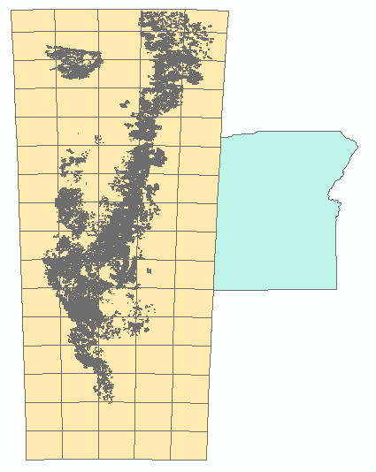
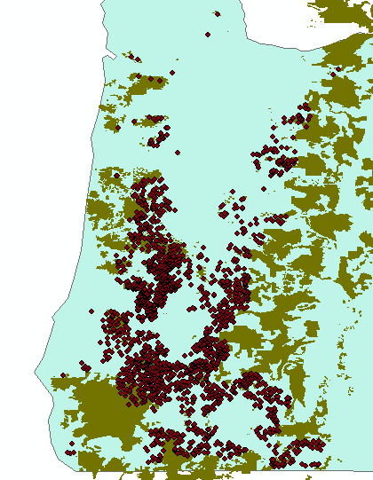
Initial Steps
Importing Coverages
Creating Geodatabase
Notes:
Much of my code is centered around importing and manipulating my source data. I found the old growth forest and owl point locations from the Oregon Natural Resources Board which had data in shapefile and coverage format. The Old Growth coverage file is seen on the left. After importing the e00, the extracted forest shapefile and owl point locations are on the right. I found the trickiest part of this to be keeping my folder locations and naming consistent and logical so that I could easily call them back for further analysis.

Slide 3
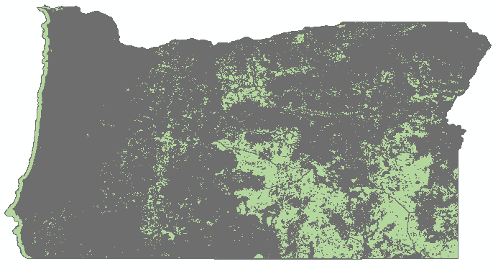
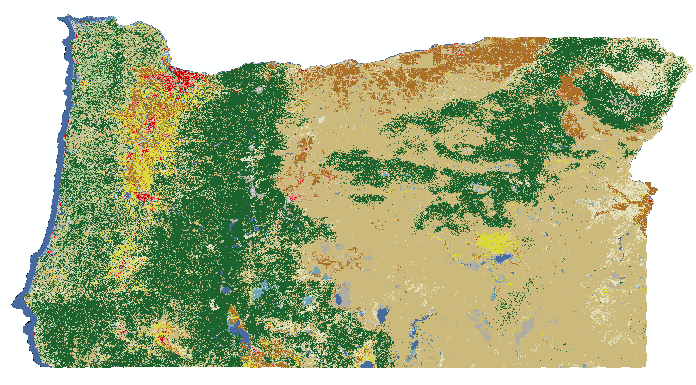
Data Manipulation
Conversion to Raster & Relating Data
Notes:
Kind of along the same lines of the previous slide, I needed to narrow the scope of my data—old growth and point locations needed to be narrowed to only within Oregon and my land cover data (from which the general forest layer would be made) needed to be converted from a statewide raster file to a forest only polygon using Convert to Raster, a Table Join (to assign landcover types to each cell) and then a Select by Attribute to finally get the layer seen above. As you can tell—something within the file (I think perhaps the initial cell size being relatively small) makes the raster not covert well. When you do not simplify the raster the above is output and when you do the coverage is very low compared to the initial raster. Because of this, I adapted the project and shifted to analysis using strictly the old growth and owl location files.

Slide 4
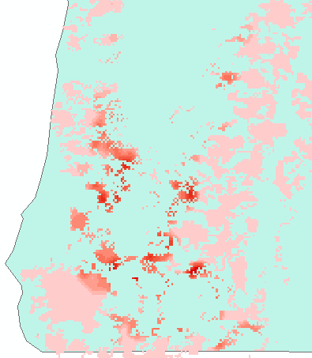
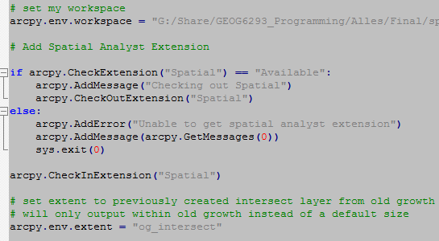
Data Analysis
Kernel Analysis
Gi* Hotspots
Notes:
I began my analysis by getting the Owl Kernel density within the Old-growth forest. As you can see, there is a slight ring that has more densely populated SOs—this is actually around several well populated areas. Once I had identified some of the more dense areas and hypothesized why they might be more populated, I decided to move forward with a hotspot analysis that would give more information on the distribution

Slide 5
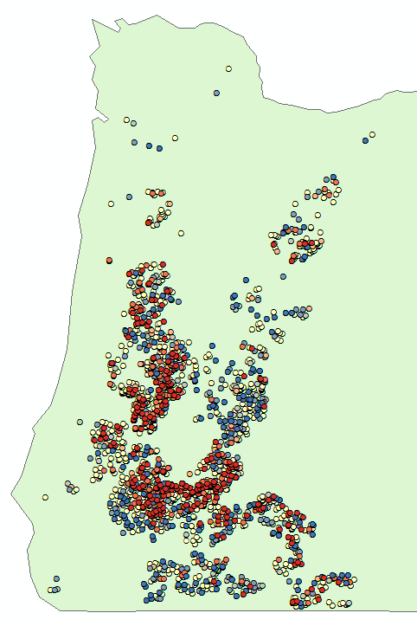
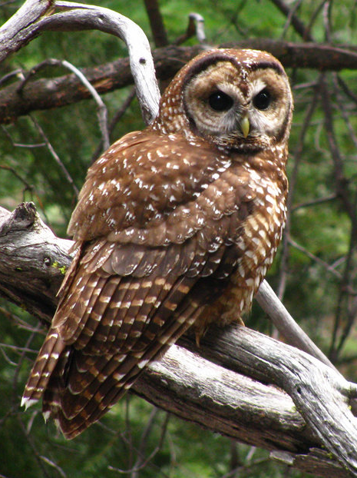
Main Points
Manipulating large/multiple data files
Scoping Research
Informing management decisions
Notes:
The hotspot analysis seemed to identify the same dense zones as the kernel density but as you can see there are some areas within that zone that were not as populated (although they still represent owl locations which is good). For further research we could look at the specific characteristics of the hotspots (those with breeding pairs or nests) such as canopy cover, distance from roadways, tree type, noise level, really an infinite number of parameters which could be used in a correlation analysis to determine the most important factors in habitat choice.
I found this project really interesting although obviously challenging given that I had to change my workflow midway through. I think the main takeaways were the usefulness of python in manipulating large datasets (either with large cell counts or with multiple identical file types). In addition, this research would be easy to replicate with other states or other species given the codes I wrote for this project—most likely easier than if you were to go through and repeat the process in Arc

